Slide 1
How the Crisis Has Changed the Economic Policy Paradigm
Scott T. Fullwiler
James A. Leach Chair in Banking and Monetary Economics
Wartburg College
Waverly, Iowa USA
Prepared for the Mosler Economic Policy Center Symposium
Franklin College, Lugano, Switzerland
April 21, 2009

Slide 2
Overview
The “New Consensus” Policy Paradigm
From New Consensus to NO Consensus
From NO Consensus to An Alterative Policy Paradigm?

Slide 3
New Consensus and Monetary Policy
Then-Fed Board Governor Frederic Mishkin
“Will Monetary Policy Become More of a Science?” Speech delivered September 2007 (Crisis Began August 2007)
9 Principles of Central Banking Derived from Advances in the “Science” of Monetary Policy in Recent Decades

Slide 4
Mishkin’s 9 Principles
Inflation is a monetary phenomenon
Benefits of Price Stability
No Long-Run Tradeoff b/n Unemployment and Inflation
The Crucial Role of Expectations
The Taylor Principle
The Time-Inconsistency Problem
Central Bank Independence
Commitment to a Nominal Anchor
Financial Frictions and the Business Cycle

Slide 5
New Consensus and Fiscal Policy
Role of Fiscal Policy Decidedly Secondary
Monetary Policy Alone Considered to Be Sufficient
Keep Politics Out of Stabilization Policy as much as Possible
Belief that Deficits Raise Real Interest Rates, Reduce Saving, and thereby Reduce Capital Accumulation

Slide 6
New Consensus and Fiscal Policy
Fiscal Sustainability . . . Need Intertemporal Budget Balance in Order to . . .
Avoid Unbounded Growth in Debt Ratio
Avoid Inflation via Unbounded Rise in Debt Service
Avoid Default Resulting from Desire to Limit Inflationary Effects of Debt Service
Avoid Negative Effects of Deficits, Inflation, and/or Default on Capital Accumulation, Growth, and Macro Stability.

Slide 7
New Consensus and Financial Regulation
Belief in Efficiency of Financial Markets and their Ability to Distribute Risk Efficiently.
Belief that Financial Innovations Enhance Financial Market Efficiency and Reduce Macro Risks.
Confidence in Market‘s Ability to Discipline Financial Institutions and Their Risk Portfolios
Belief that Central Banks Should Not Target Asset Prices . . . Bubbles Cannot Be Known w/ Certainty Until After the Fact

Slide 8
New Consensus and Its Influence on the Macro Policy Mix
Monetary Policy:
Independence, Inflation Targets, Taylor Rule, ECB
Fiscal Policy:
Maastricht, “Generational Accounting” in US
Financial (De)Regulation:
Basel II and Banks’ “Internal Models”
Gramm-Leach Bliley, Futures and CDS Deregulation
Greenspan/Bernanke both Avoid “Pricking” Bubbles, Praise Securitization and Macro Benefits of Structured Finance through 2006

Slide 9
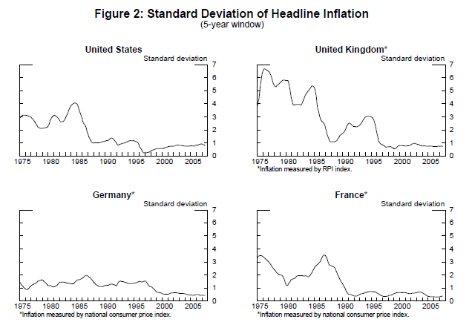
Mishkin on the so-called “Great Moderation”

Slide 10
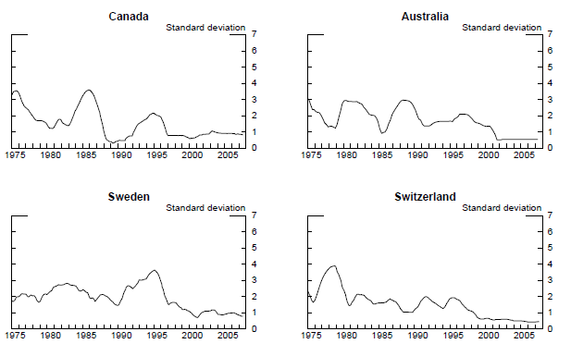
Mishkin on the so-called “Great Moderation”

Slide 11
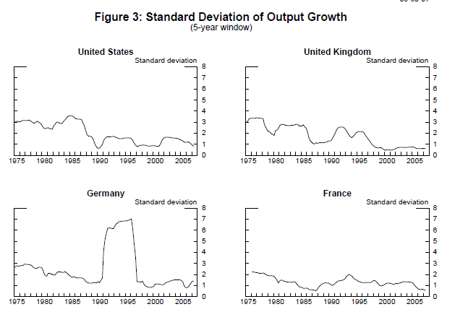
Mishkin on the so-called “Great Moderation”

Slide 12
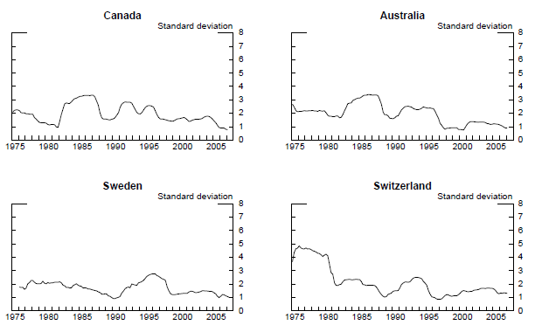
Mishkin on the so-called “Great Moderation”

Slide 13
Overview
The “New Consensus” Policy Paradigm
From New Consensus to NO Consensus
From NO Consensus to An Alterative Policy Paradigm?

Slide 14
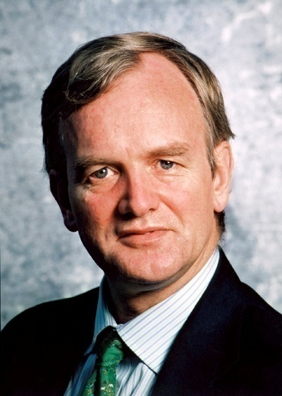
New Consensus and Financial Instability
Willem Buiter, FT.com, 3 March 2009
“The Monetary Policy Committee of the Bank of England I was privileged to be a ‘founder’ external member of during the years 1997-2000 contained . . . a strong representation of academic economists.”
“This turned out to be a severe handicap when the central bank had to switch gears and change from being an inflation-targeting central bank under conditions of orderly financial markets to a financial stability-oriented central bank under conditions of widespread market illiquidity and funding illiquidity.”

Slide 15
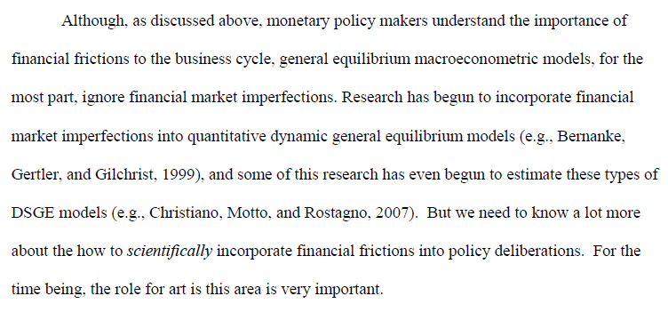
Excerpt from Mishkin, September 2007

Slide 16
NO Consensus and Monetary Policy
The World’s 2 Largest Economies Effectively Have Zero Interest Rate Policies (ZIRP)
Japan since 1998
US since December 2008
New Consensus Says If Output Gap Persists, Solution Is to Reduce Real Rate of Interest
NO Consensus for How to Do This with Nominal Interest Rate at the Zero Bound

Slide 17
NO Consensus and Monetary Policy
Japan’s “Quantitative Easing” during 2001-2005
Based upon ‘Money Multiplier’
BOJ Flooded Banks with Excess Reserves
Monetary Base Reached 25% of GDP in 2005
Consensus that ZIRP Was Insufficient, but NO Consensus regarding Effectiveness of Quantitative Easing.

Slide 18
NO Consensus and Monetary Policy
US Actions in the Recent Crisis Labeled “Credit Easing” by Bernanke, to Distinguish Fed’s Approach from Japan’s Approach.
SF Fed President Janet Yellen: “The Fed’s balance sheet strategy has a different motivation [than the BOJ’s approach]. We are focused on pursuing carefully tailored programs to remedy specific financial market dysfunctions.”

Slide 19
Fed Actions Beyond Near-Zero Fed Funds Target
Expanded Use of Discount Lending
New Standing Facilities
Term Auction Facility (TAF)
Primary Dealer Credit Facility (PDCF)
Treasury Securities Lending Facility (TSLF)
Commercial Paper Facilities (ABCP and CPFF)
Money Market Investor Funding Facility (MMIFF)
Open Market Operations
Increased Repos in Agencies instead of Tsy’s
Agency Mortgage Backed Securities Purchase Program
Term Asset-Backed Securities Loan Facility (TALF)
Bear Stearns, AIG, Citigroup, Bank of America

Slide 20
Changes in Fed’s Balance Sheet Size & Composition

Slide 21
Changes in Fed’s Balance Sheet Size & Composition

Slide 22
NO Consensus on Effects of Fed’s Actions
Fed’s View:
Standing Facilities and TALF are Lender of Last Resort-type of actions to ‘prop up’ credit markets temporarily, reduce historically high spreads.
Rising Reserve Balances Necessary Given that Lender of Last Resort Needs Are Greater than Securities Available to Sell as Sterilization
Interest Payment on Reserve Balances Enables Fed to Expand Balance Sheet as Conditions Warrant and Still Achieve Positive Target Rate ( Currently 0% to 0.25%, Averaging Around 0.2%)
Notes:
Could add here that Fed views high qty of rbs

Slide 23
NO Consensus on Effects of Fed’s Actions
Other views:
Fed Is Copying Japan’s Quantitative Easing
So many reserves earning target rate (about .25%) that banks have no incentive to lend
So many reserves that inflation is “right around the corner”
Current “discretionary interventions” inconsistent with success of New Consensus during Great Moderation

Slide 24
NO Consensus and Fiscal Policy

Slide 25
NO Consensus and Fiscal Policy
Yellen, 1 January 2009 at American Econ. Association
“In his paper for this session, John [Taylor] asserts that the BOJ’s quantitative easing strategy worked well, while fiscal policy was ineffective. My interpretation of the evidence is exactly the opposite. . . . [The BOJ’s] expansion of excess reserves to extraordinary levels appears , on its own, to have had very little impact. . . . For all these reasons I support Marty’s [Martin Feldstein’s] conclusion that there is an exceptionally strong case for substantial fiscal stimulus over the next few years.”

Slide 26
NO Consensus and Fiscal Policy
John Cochrane, U of Chicago
“Most fiscal stimulus arguments are based on fallacies”
John Taylor, Stanford
“A decade ago there was widespread agreement that fiscal policy should avoid large scale discretionary actions . . . [and] . . . I see no empirical rationale for a revival of [such actions].”
Thomas Sargent, NYU
“Calculations . . . supporting stimulus . . . Ignore what we’ve learned in the last 60 years”

Slide 27
NO Consensus and Financial Sector
Greenspan Laments that Financial Markets Were Not Good at Assessing Risk
View that Fed Should Concern Itself with Asset Prices Is More Widely Held
Shifting Responses to Failures of Large Financial Institutions . . . Recognize No Mechanism Exists for Resolving These Failures
Bernanke, Treasury, Others Favor “Systemic Risk Regulator” and Treasury Stress Testing (As Opposed to “Internal Models”)
Growing Sentiment that “Too Big to Fail” Means “Too Big”
Overall, Shift Away from New Consensus View, but No Consensus Regarding What To Do and How To Do It

Slide 28
From New Consensus to NO Consensus
NO Consensus on How to Proceed with Monetary Policy, Fiscal Policy, and Regulatory Policy in the Current Environment
NO Consensus Among Policy Makers or Economists on Whether Recent Changes to Each Will Be Effective
Current Crisis and Policy Responses Were (for the most part) Not Part of the New Consensus Research Program

Slide 29
Overview
The “New Consensus” Policy Paradigm
From New Consensus to NO Consensus
From NO Consensus to An Alterative Policy Paradigm?

Slide 30
Wanted: An Alternative Policy Paradigm
Willem Buiter, FT.com, 3 March 2009
“ I believe that the Bank [of England] has by now shed the conventional wisdom of the typical macroeconomics training of the past few decades. In its place is an intellectual potpourri of factoids, partial theories, empirical regularities without firm theoretical foundations, hunches, intuitions, and half-developed insights.”

Slide 31
Policy Paradigm for a Non-Convertible
Currency-Issuing Government

Slide 32
Policy Paradigm for a Non-Convertible
Currency-Issuing Government
Central Bank Reserves DO NOT Fund or Otherwise Restrict Bank Loans Except Under a Gold Standard or Currency Board Regime

Slide 33
Policy Paradigm for a Non-Convertible
Currency-Issuing Government
Mainstream view of reserve balances (RBs) is that they “finance” bank balance sheet expansion via rising excess reserves (ER)
↑RBs → ↑ER → ↑Loans and ↑Deposits
Money multiplier (1/rrr in its simplest form) then tells how much loans and deposits can increase given a rise in RBs and ER

Slide 34
Policy Paradigm for a Non-Convertible
Currency-Issuing Government
Money multiplier is a gold standard model. Otherwise, loans create deposits.
That is, a bank’s ability to expand its balance sheet not limited by quantity of RBs or fractional RR
Assets Liabilities & Equity
+ 100 Loan +100 Deposit

Slide 35
Policy Paradigm for a Non-Convertible
Currency-Issuing Government
To Meet Reserve Requirements or Deposit Outflows, Reserves Are Obtained in Money Markets or from Central Bank at a Stated Rate.
Thus, Extending Credit and Creating New Bank Liabilities Are Unrelated to the Quantity of Reserves
Expanding Its Balance Sheet Creates a Potential Short Position in Reserves for a Bank, which Can Affect the Profitability of a Loan, NOT the Bank’s Ability to Create the Loan

Slide 36
Policy Paradigm for a Non-Convertible
Currency-Issuing Government
Implications for the Current NO Consensus
BOJ’s Quantitative Easing Does NOT raise Bank Lending or Inflation
Bank Lending Ability Unaffected by Fed’s Increased Balance Sheet or Bank Reserves.
Nonsensical To Say That “Banks Are Not Lending Their Excess Reserves” or “Banks Are Not Lending Government Invested Funds”
Banks Increase Lending when a Creditworthy Borrower Wants a Loan and the Loan Seems Profitable

Slide 37
Policy Paradigm for a Non-Convertible
Currency-Issuing Government
2. Central Bank Operations Are About Interest Rates, Not Quantity of Reserves or “Money”

Slide 38
Policy Paradigm for a Non-Convertible
Currency-Issuing Government
Because Banks Do NOT Fund Loans with Reserves (and for other technical reasons), Central Bank’s Only Operational Target is an Interest Rate Target.
Central Banks Set Target Rates According to Their Preferences (as Opposed to Market Forces) Given a Non-Convertible Currency
As Monopoly Supplier of Reserves, a Central Bank Can Similarly Set Rates at Any Point in the Term Structure or In Any Particular Credit Market (Given Authority to Do So)

Slide 39
Policy Paradigm for a Non-Convertible
Currency-Issuing Government
Implications for the Current NO Consensus
Mosler Proposed in August 2007 that the Fed Lend in Unlimited Quantities to All Member Banks Up to 6 Months at Predetermined Rates
Fed Gets Closer Over Time to Mosler’s Proposal
However, in Some Important Cases, Fed Sets Quantities (for TAF and TALF) while Hoping to Impact Interest Rate Spreads
Fed Could Instead Stabilize Spreads by Simply Announcing Its Price

Slide 40
Policy Paradigm for a Non-Convertible
Currency-Issuing Government
3. Currency-Issuing Government’s Spend by Simultaneously Crediting Bank Reserve and Recipient Deposit Accounts

Slide 41
Policy Paradigm for a Non-Convertible
Currency-Issuing Government
Government Spending Occurs via the Simultaneous Crediting of Reserves and Deposits
This Involves Simply Entering Numbers on an Electronic Spreadsheet
Government Spending Is Not Constrained by Taxation or Bond Sales, Since These Are Likewise Simply Debits to Reserves and Deposits on Electronic Spreadsheets
Solvency Is NEVER an Issue for a Non-Convertible Currency-Issuing Government

Slide 42
Policy Paradigm for a Non-Convertible
Currency-Issuing Government
Implications for the Current NO Consensus
Rise in Deficits in US Does NOT Threaten Solvency of the US Government

Slide 43
Policy Paradigm for a Non-Convertible
Currency-Issuing Government
4. Government Deficits Create Net Saving for the Non-Government Sector

Slide 44
Policy Paradigm for a Non-Convertible
Currency-Issuing Government
Belief that Saving Finances Investment (Loanable Funds Market) Is Only Valid in a Gold Standard or Currency Board Regime
Loans Create Deposits, so NO “Pool” of Loanable “Funds” Sitting Anywhere and NO “Crowding Out” (Applies to Gold Standard Only)
Instead, Better to Consider “Net” Saving of Different Sectors of the Economy as It Relates to Financial and Macroeconomic Stability

Slide 45
Policy Paradigm for a Non-Convertible
Currency-Issuing Government
PRIVATE SECTOR
(HOUSEHOLDS AND
BUSINESSES)
$$$
$$$
PUBLIC SECTOR
(FEDERAL, STATE,
LOCAL GOVERNMENT)
FOREIGN SECTOR
(EXPORTS, IMPORTS)
$$$

Slide 46
Policy Paradigm for a Non-Convertible
Currency-Issuing Government

Slide 47
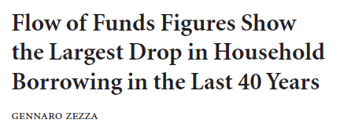
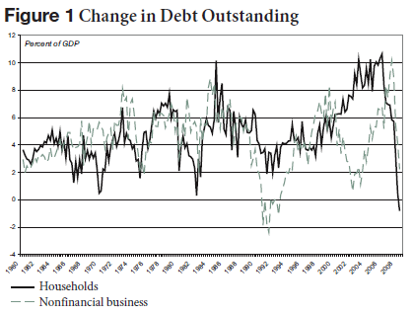
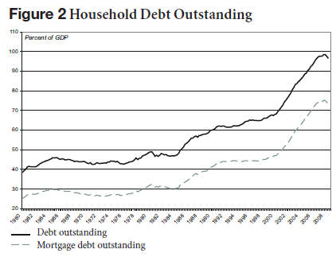
Policy Paradigm for a Non-Convertible
Currency-Issuing Government

Slide 48
Policy Paradigm for a Non-Convertible
Currency-Issuing Government
Implications for the Current NO Consensus
Current Deficits Are Raising Net Saving in the Private Sector and Enabling Deleveraging
No “Crowding Out” of Funds Available for Private Sector Borrowing . . . Deficits Are Creating Net Saving
A Larger Deficit Would Enable Still More Net Saving and Deleveraging!

Slide 49
Policy Paradigm for a Non-Convertible
Currency-Issuing Government
5. Bond Sales by a Non-Convertible Currency-Issuing Government are for Interest-Rate Maintenance, NOT Financing

Slide 50
Policy Paradigm for a Non-Convertible
Currency-Issuing Government
Because a Deficit Is a Net Increase in Reserves . . .
Absent Government Bond Sales, a Deficit Reduces the Overnight Rate Below the Central Bank’s Target
Either the Government or the Central Bank MUST Sell a Bond in Order to Achieve the Central Bank’s Interest Rate Target
Bond Sales Are NOT Financing Operations

Slide 51
Policy Paradigm for a Non-Convertible
Currency-Issuing Government
Implications for the Current NO Consensus
Interest on Long-Term Bonds
Japan < 2%
US at Historical Lows, too (10 year < 3%)
So . . . Again, NO Crowding Out, and NO Interest Payments Growing Without Bound
Charles Goodhart Recently Proposed UK Treasury Sell NO Bonds at All. Mosler Has Long Proposed this for US
Fed May Issue Bonds to Drain Reserves and Support A Higher Interest Rate Target Once Crisis Is Over

Slide 52
Policy Paradigm for a Non-Convertible
Currency-Issuing Government
Implications for the Current NO Consensus
In Short, “Dangers” of Deficits Are Only Relevant Under Gold-Standard, Currency Unions, or Fixed Exchange Rates
Only Applicable Danger of Deficits is Inflation in the Case of Capacity Constraints, which Is Not A Current Concern

Slide 53
Policy Paradigm for a Non-Convertible
Currency-Issuing Government
The Legacy of Hyman Minsky:
The Banking/Financial System Should Support Economic Expansion and Not Contribute to Systemic Risk

Slide 54
Policy Paradigm for a Non-Convertible
Currency-Issuing Government
Bank Liabilities:
Because Bank Liabilities Are Government Insured, Don’t Impose “Market Discipline” there
Lend to Banks in Unlimited Quantities at Stated Policy Rates . . . (This Is NOT Bubble-Inducing)
Interbank Markets Are Unnecessary
Bank Assets:
Banks Should Lend on Credit Analysis
Originate and Hold (instead of Distribute)
Banks Mark-to-Regulator-Approved Credit Model

Slide 55
Policy Paradigm for a Non-Convertible
Currency-Issuing Government
Regulation of the Financial System
Systemic Risk Regulation Based on Size and Timing of Cash Flows (NOT Expected Capital Gains!)
2 Big to Fail = 2 Big to Exist
Basel Approach Criticized for Being Insufficient for Systemic Stability, even Counterproductive
Overarching Approach Recognizing Procyclical Nature of the Banking and Financial System (Asset Values, Leverage)

Slide 56
Policy Paradigm for a Non-Convertible
Currency-Issuing Government
Implications for the Current NO Consensus
Fed Slow to Lend to Banks in Unlimited Quantities at Announced Rates, which Worsened Spreads and Counterparty Risks
Mosler Proposal to Replace Geithner Plan
Banks Purchase FDIC Credit Default Insurance for “Toxic” Assets at Fixed Price Voluntarily
Goodhart Notes this Is Similar to UK Plan
As Mentioned, Current Move Toward Systemic Regulation; Many Are (Re)Reading Minsky

Slide 57
Policy Paradigm for a Non-Convertible
Currency-Issuing Government
7. The Legacy of John Maynard Keynes:
Active, Discretionary Fiscal Policy Is Appropriate and Necessary Given the Procyclical Nature of the Banking/Financial System

Slide 58
Policy Paradigm for a Non-Convertible
Currency-Issuing Government
Current Approach in US
“Economy Won’t Get Moving Until Finance/Banking Are ‘Fixed’”
“Need Banks to Start Lending First”
So . . . We Simultaneously Hear that Banks Are Solvent But Also Need $Trillions to Remove “Toxic” Assets

Slide 59
Policy Paradigm for a Non-Convertible
Currency-Issuing Government
Problem with the Current Approach in US
Banking/Finance Are Procyclical
Increased Lending By Definition Is Re-Leveraging of Private Sector
Private Sector Wants to DE-leverage, NOT releverage!
Debt and Debt Service Ratios Previously at Historical Highs
Current Deleveraging Now Also at Record Pace

Slide 60
Policy Paradigm for a Non-Convertible
Currency-Issuing Government
Problem with the Current Approach in US
In Order for Private Sector to Deleverage, Government or International Sector Must Leverage
Improvement in Trade Balance Requires Other Nations to Run Trade Deficits (Unlikely)
Simplest Solution Is Government Re-Leveraging while Private Sector Deleverages (KEYNES!)
This Is A Nominal, NOT Real, Crisis
Awaiting the Next Obama Stimulus Package
Not an Option Under Gold Standard, Currency Board, Currency Union (Maastricht)

Slide 61
Policy Paradigm for a Non-Convertible
Currency-Issuing Government

Slide 62
Policy Paradigm for a Non-Convertible
Currency-Issuing Government

Slide 63
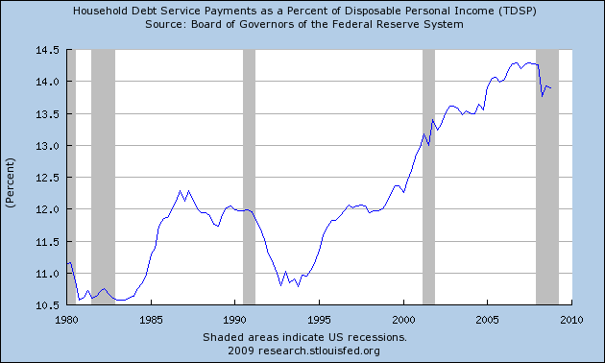
Policy Paradigm for a Non-Convertible
Currency-Issuing Government

Slide 64
Conclusion . . .
Crisis Has Led to Policy Debates for Which There Is No Current Consensus Regarding Causes or Solutions
New Consensus as Described by Mishkin Is of Arguably Little Importance or Relevance in these Debates, as Buiter Laments
Some Welcome Movement in the Direction of an Arguably More Relevant, Alternative Paradigm, but Still Incomplete, Poorly Understood, and Mostly Accidental (for now?)
Large Government Deficits to Support Aggregate Demand and Enable Desired Private Sector Net Saving
Monetary Policy to Set (Low) Interest Rates and Promote Financial System Functioning via Standing Facilities
Regulatory Policy to Refocus on Macro Risks and Procyclicality

